Slide 1
Chapter 2
Project Management
and
Processes

Slide 2
Projects Cannot Be Run in Isolation
Projects must operate in a broad organizational environment
Project managers need to take a holistic or systems view of a project and understand how it is situated within the larger organization

Slide 3
Systems view of a project and project management
To view a project with a systems perspective is to see the whole internal and external operational landscape in which the project will be functioning
An example of a system is the cardiovascular process of the human body
a project without considering the holistic view of the organization, the systems approach, will likely fail

Slide 4
A Systems View of Project Management
A systems approach emerged in the 1950s to describe a more analytical approach to management and problem solving
Three parts include:
Systems philosophy: View things as systems, interacting components working within an environment to fulfill some purpose
Systems analysis: problem-solving approach
Systems management: Address business, technological, and organizational issues before making changes to systems

Slide 5
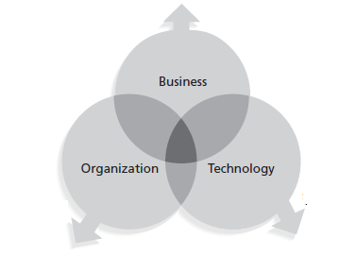
Systems Approach to Project Management
Using a systems approach is critical to successful project management
Three-Sphere Model for Systems Management
•What will the laptop project cost the college?
•What will it cost students?
•What will support costs be?
•What will the impact be on enrollments?
Laptop Project
•Should the laptops use Macintosh,
Windows, or both types of operating systems?
•What applications software will be loaded?
•What will the hardware specifications be?
•How will the hardware impact LAN and Internet access?
•Will the laptop project affect all students, just traditional students, or only certain majors?
•How will the project affect students who already have PCs or laptops?
•Who will train students, faculty, and staff?
•Who will administer and support training?

Slide 6
Understanding Organizations
Structural frame: Focuses on roles and responsibilities, coordination and control. Organizational charts help define this frame.
Human resources frame: Focuses on providing harmony between needs of the organization and needs of people.
Political frame: Assumes organizations are coalitions composed of varied individuals and interest groups. Conflict and power are key issues.
Symbolic frame: Focuses on symbols and meanings related to events. Culture is important.

Slide 7
Recognize the Importance of Project Stakeholders
Recall that project stakeholders are the people involved in or affected by project activities
Project managers must take time to identify, understand, and manage relationships with all project stakeholders
Using the four frames of organizations can help meet stakeholder needs and expectations
Senior executives are very important stakeholders

Slide 8
Many Organizations Focus on the Structural Frame
Most people understand what organizational charts are
Many new managers try to change organizational structure when other changes are needed
3 basic organizational structures
Functional
Project
Matrix

Slide 9
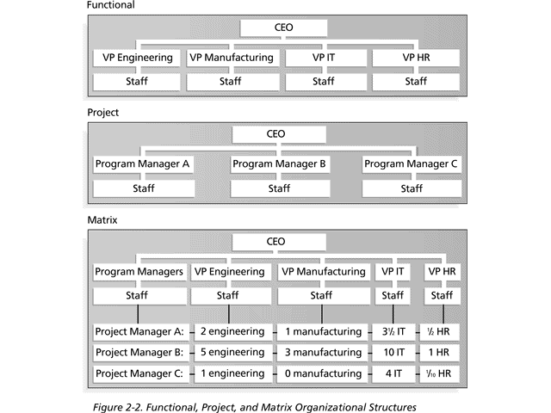
Basic Organizational Structures

Slide 10
What Is Project Success?
A standard must be established by which to define and measure project success.
Project success is the delivery of the required product, service, or result on time and within budget.
What Makes Projects Succeed?
Projects may fail because of technical and non-technical aspects.
However, projects frequently fail for non-technical reasons such as:
Lack of commitment on the part of staff,
political gaffes, and
The inability to communicate ideas effectively

Slide 11
What Helps Projects Succeed?
According to the Standish Group’s report “CHAOS 2001: A method for Success,” the following items help IT projects succeed, in order of importance:
Executive support
User involvement
Experienced project manager
Clear business objectives
Constant and effective
communication to everyone
Minimized scope
Standard software infrastructure
Firm basic requirements
Formal methodology
Reliable estimates

Slide 12
Need for Top Management Commitment
Several studies cite top management commitment as one of the key factors associated with project success
Top management can help project managers
Secure adequate resources
Get approval for unique project needs in a timely manner
Receive cooperation from people throughout the organization
Learn how to be better leaders

Slide 13
Fifteen Project Management Job Functions*
Define scope of project
Identify stakeholders, decision-makers, and escalation procedures
Develop detailed task list (work breakdown structures)
Estimate time requirements
Develop initial project management flow chart
Identify required resources and budget
Evaluate project requirements
Identify and evaluate risks
Prepare contingency plan
Identify interdependencies
Identify and track critical milestones
Participate in project phase review
Secure needed resources
Manage the change control process
Report project status
*Northwest Center for Emerging Technologies, "Building a Foundation for Tomorrow: Skills Standards for Information Technology,“ Belleview, WA, 1999

Slide 14
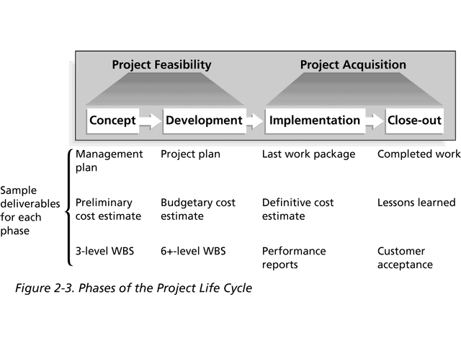
Phases of the Project Life Cycle

Slide 15
Product Life Cycles
Products also have life cycles
The Systems Development Life Cycle (SDLC) is a framework for describing the phases involved in developing and maintaining information systems
Systems development projects can follow
Predictive models: the scope of the project can be clearly articulated and the schedule and cost can be predicted
Adaptive models: projects are mission driven and component based, using time-based cycles to meet target dates

Slide 16
Predictive Life Cycle Models
The waterfall model has well-defined, linear stages of systems development and support
The spiral model shows that software is developed using an iterative or spiral approach rather than a linear approach
The incremental release model provides for progressive development of operational software
The prototyping model is used for developing prototypes to clarify user requirements
The RAD model is used to produce systems quickly without sacrificing quality

Slide 17
Project Management Process
Small projects will produce a project initiation checklist. Medium and large projects will produce a project initiation report
The project Initiation report is an overall plan for carrying out the whole project, and a more detailed plan for the next stage of the project. It consists of:
clearly defined objective,
clearly defined dimensions of scope,
overall schedule of activities for the project (project plan), -project organization,
clearly defined project control procedures to check and confirm quality,
usage of resources, costs and time, manage change and track issues,
clearly stated business justification for the project,
Project budget.

Slide 18
Project Management Process
Upon completion of the project initiation stage the project board will make one of two decisions:
Go / No go for the whole project.
Go / No go for the next stage
What is a Project Management Life Cycle?
The process each manager follows during the life of a project is called the Project Management Life Cycle.
The Initiation Phase
The Project Planning Phase
Project Executions and Control Phase
Project Close-Out Phase

Slide 19
Project Management Process Groups
Project management can be viewed as a number of interlinked processes
The project management process groups include
Initiating Processes
Planning Processes
Executing Processes
Controlling Processes
Closing Processes

Slide 20
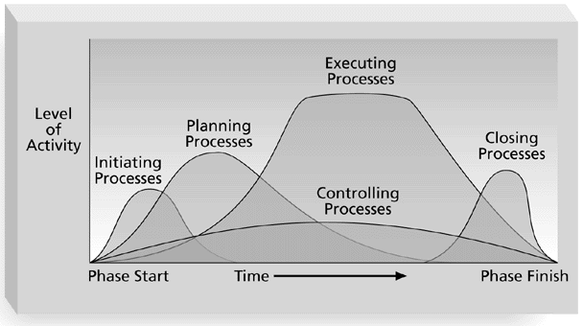
Overlap of Process Groups in a Phase

Slide 21
Project Initiation
Initiating a project includes recognizing and starting a new project or project phase
Some organizations use a pre-initiation phase, while others include items like developing a business case as part of initiation
The main goal is to formally select and start off projects
Key outputs include:
Assigning the project manager
Identifying key stakeholders
Completing a business case
Completing a project charter and getting signatures on it

Slide 22
Project Planning
The main purpose of project planning is to guide execution
Every knowledge area includes planning information
Key outputs include:
A team contract (team_contract.doc)
A scope statement (scope_statement.doc)
A work breakdown structure (WBS) (wbs.doc)
A project schedule, in the form of a Gantt chart with all dependencies and resources entered
A list of prioritized risks

Slide 23
Project Gantt Chart

Slide 24
Project Executing
It usually takes the most time and resources to perform project execution since the products of the project are produced here
The most important output of execution is work results
Project managers must use their leadership skills to handle the many challenges that occur during project execution

Slide 25
Project Controlling
Controlling involves:
Measuring progress toward project objectives,
Monitoring deviation from the plan, and
Taking corrective actions
Controlling affects all other process groups and occurs during all phases of the project life cycle
Status and progress reports are important outputs of controlling

Slide 26
Project Closing
The closing process involves gaining stakeholder and customer acceptance of the final product and bringing the project, or project phase, to an orderly end
Even if projects are not completed, they should be closed out to learn from the past
Project archives and lessons learned are important outputs.
Most projects include a final report and presentations

Slide 27
Post-Project Follow-up
Many organizations have realized that it’s important to review the results of projects a year or so after they have been completed
Many projects project potential savings, so it’s important to review the financial estimates and help learn from the past in preparing new estimates

Slide 28
end of ch-2

